Slide 1
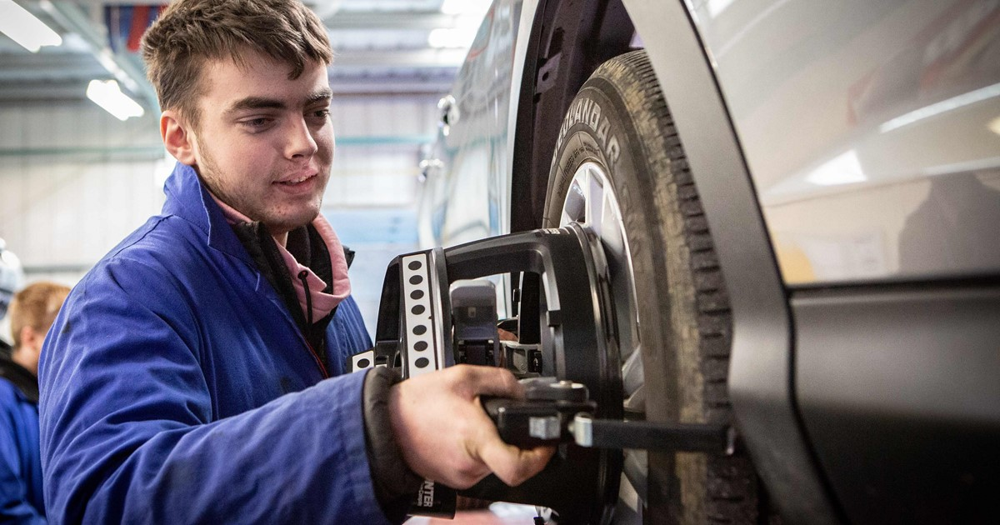
GCSE Motor Vehicles

